Slide 1

Slide 1
Analysis Visual Report on Supermarket Business
DATA DRIVEN
Power Point Presentation

Slide 2
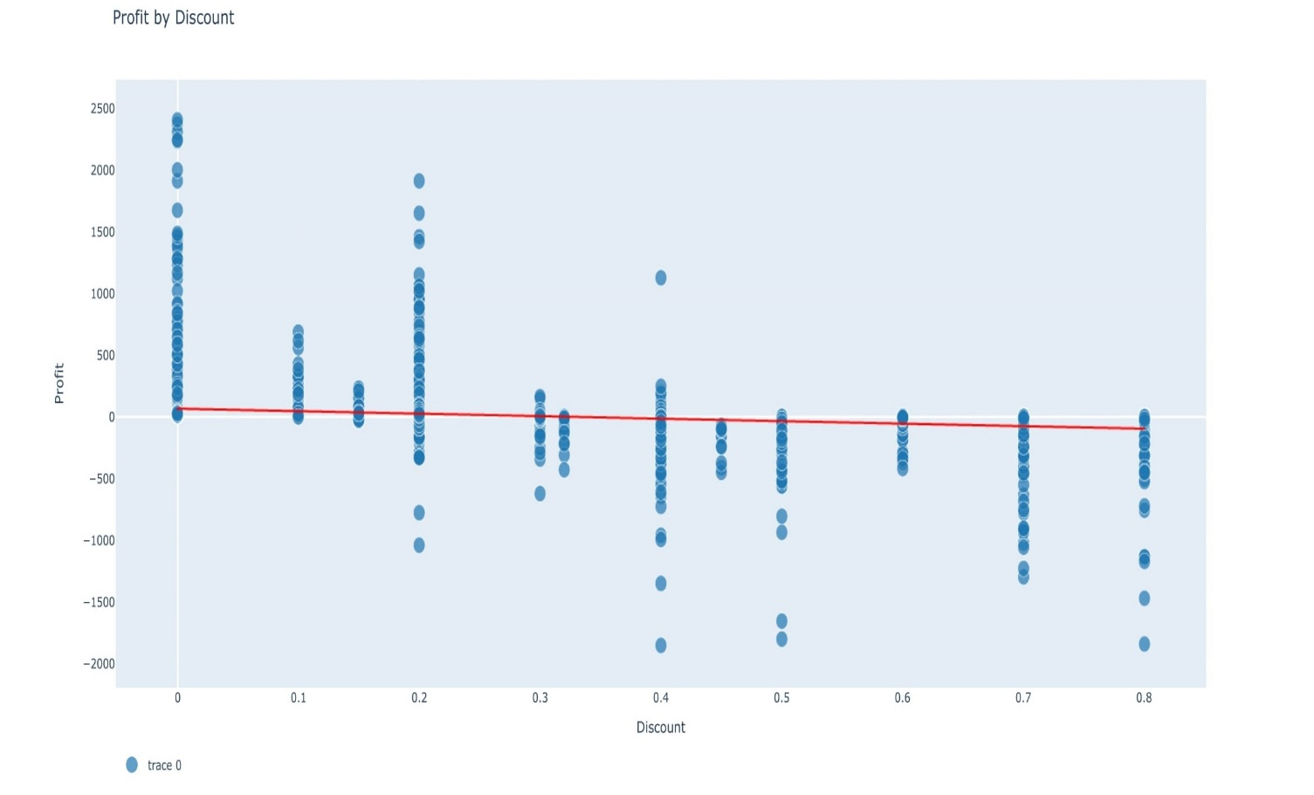
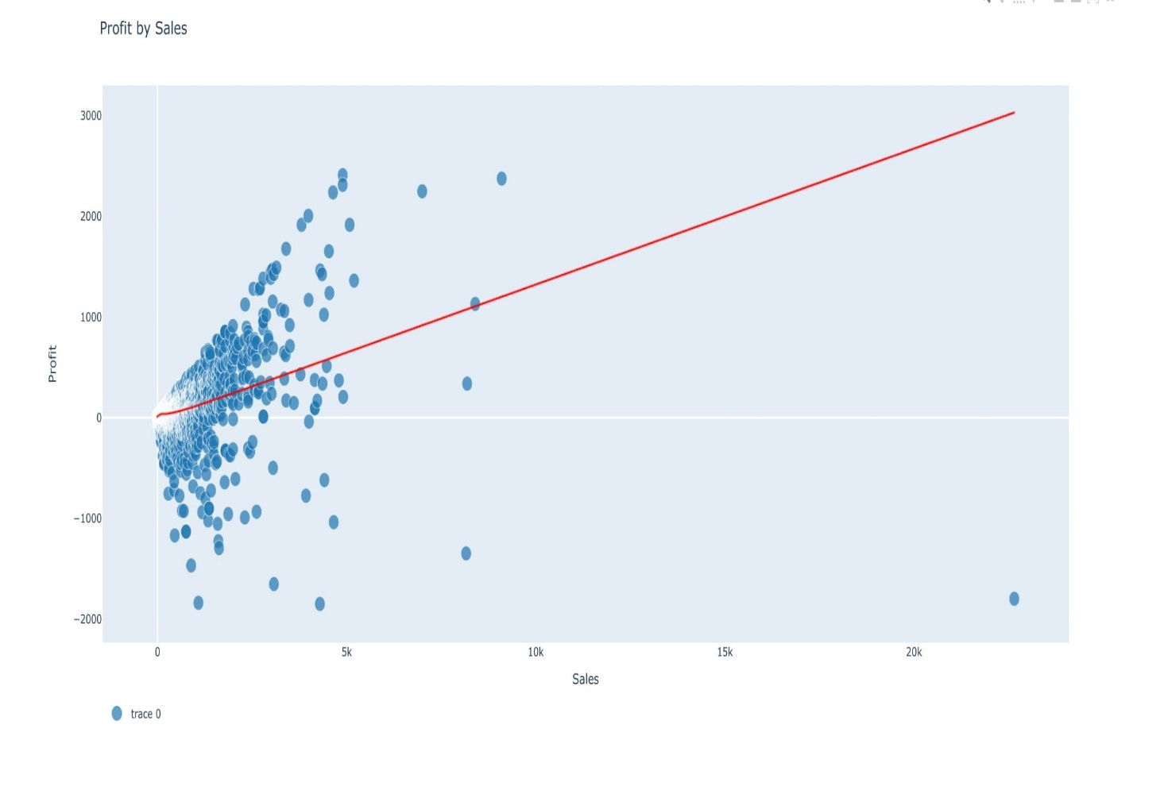
Profit variation with Sales and Discount

Slide 3
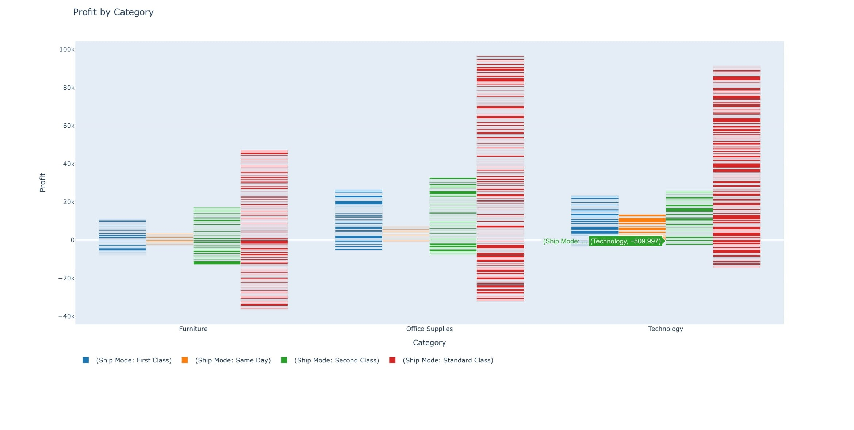
Profits in different product Categories based on Ship Mode

Slide 4
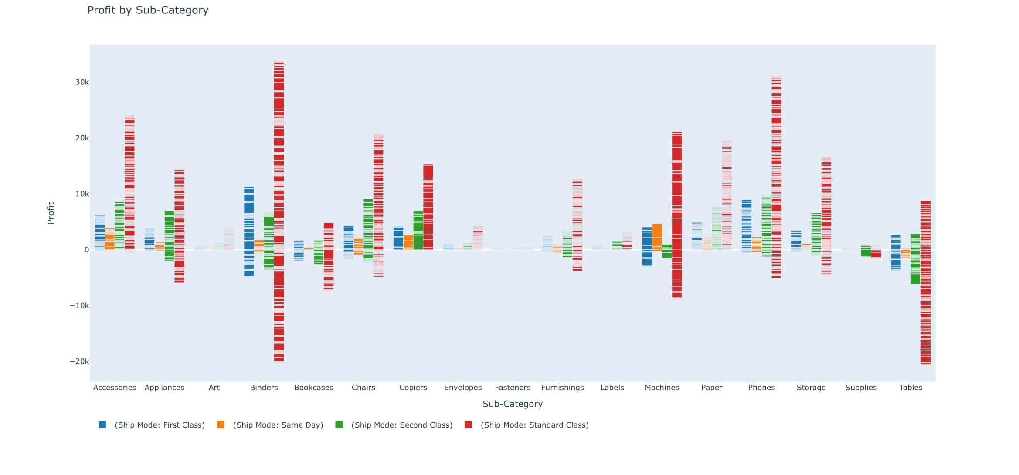
Profits in different subcategories based on Ship Mode

Slide 5
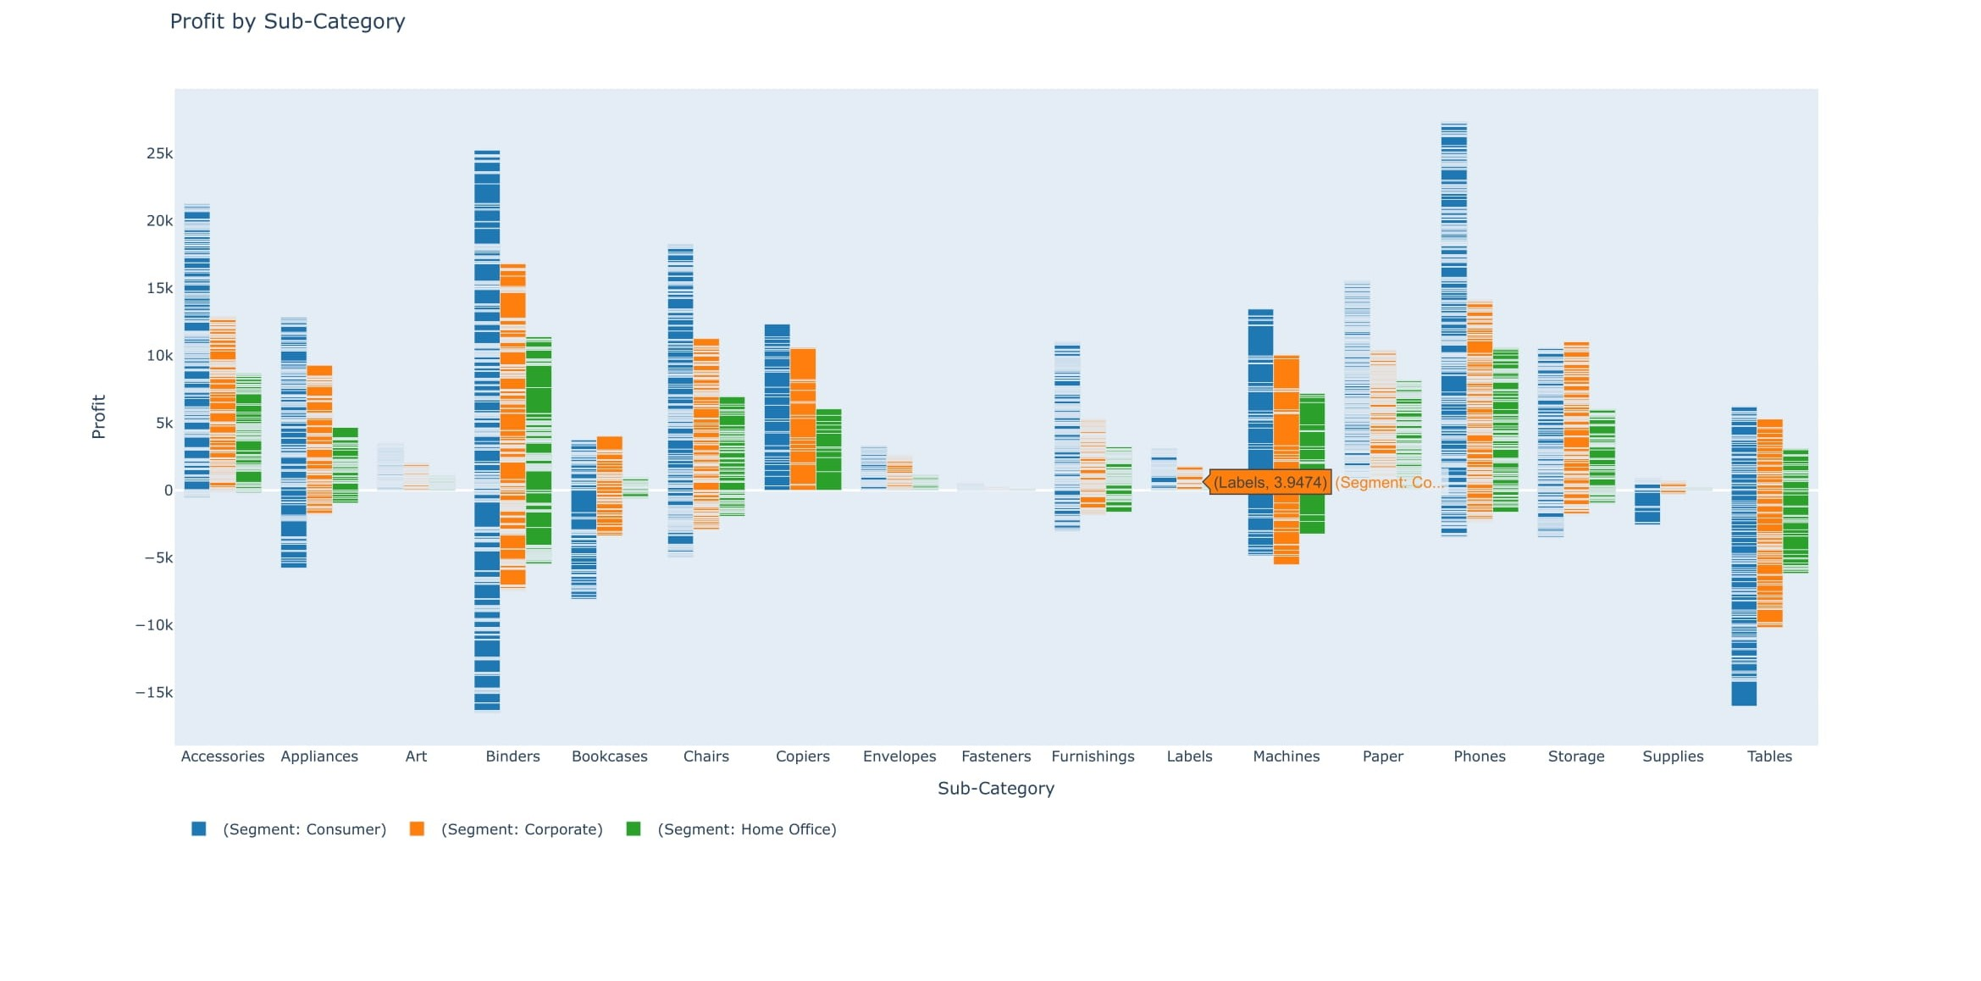
Profits in Subcategories based on Customer Segments

Slide 6
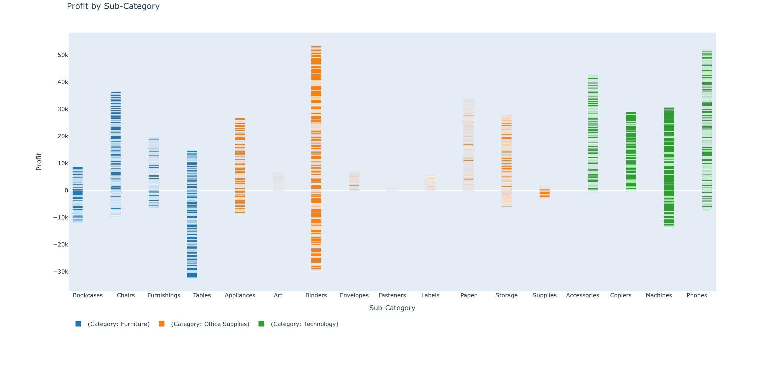
Profits on Subcategories based on Categories

Slide 7
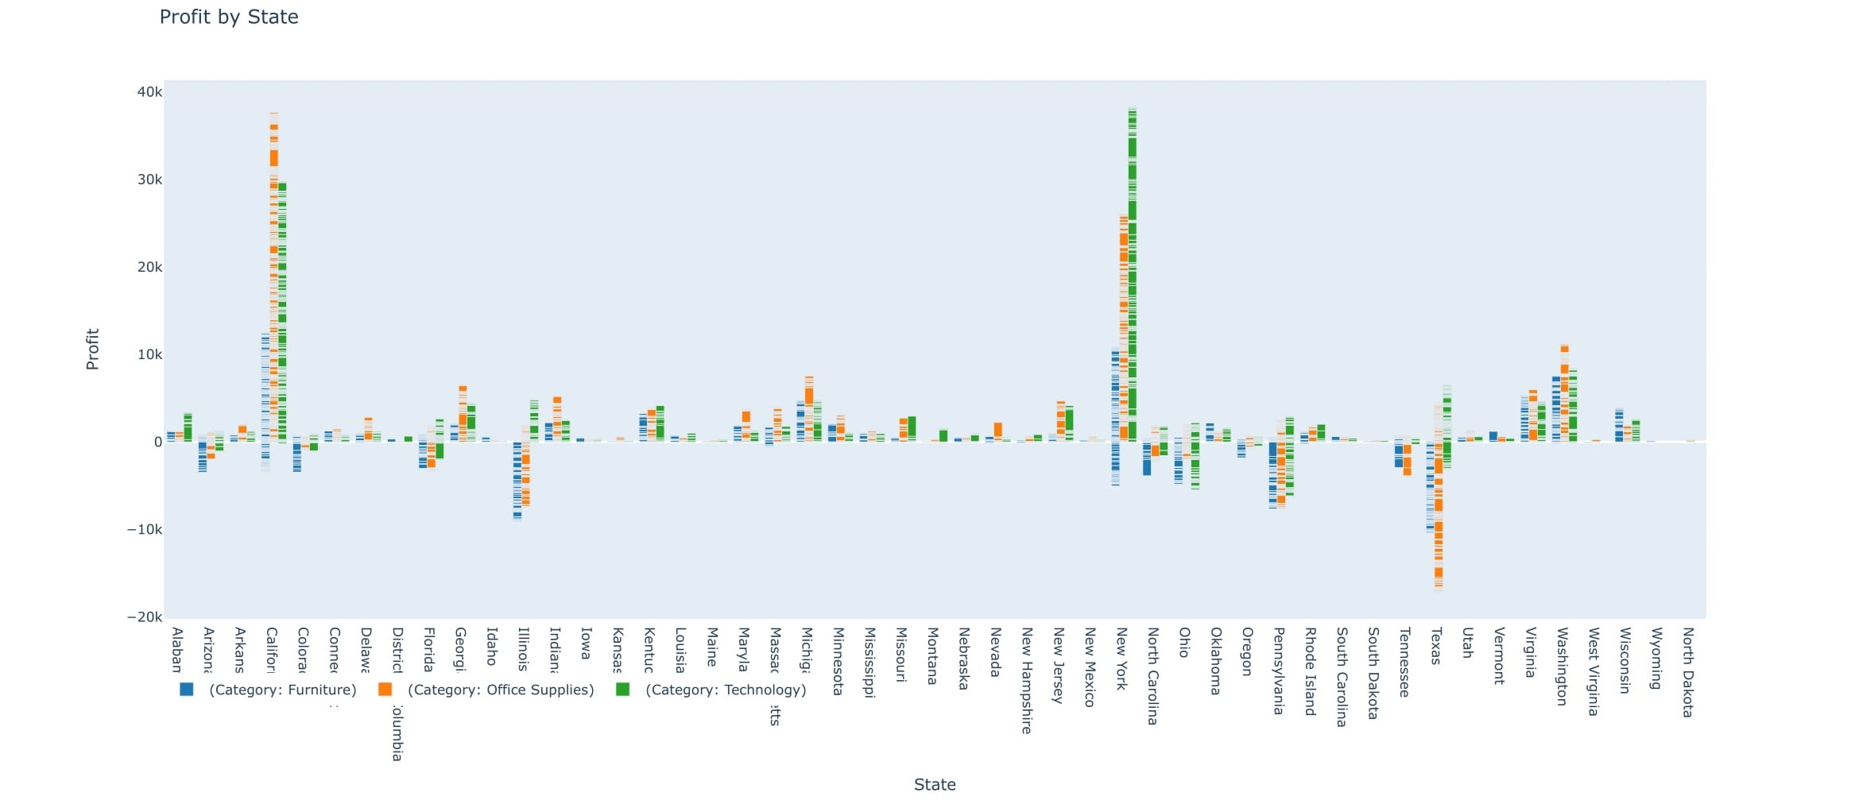
Profits in different States based on the Categories

Slide 8

Slide 11
THANK YOU

